Slide 1
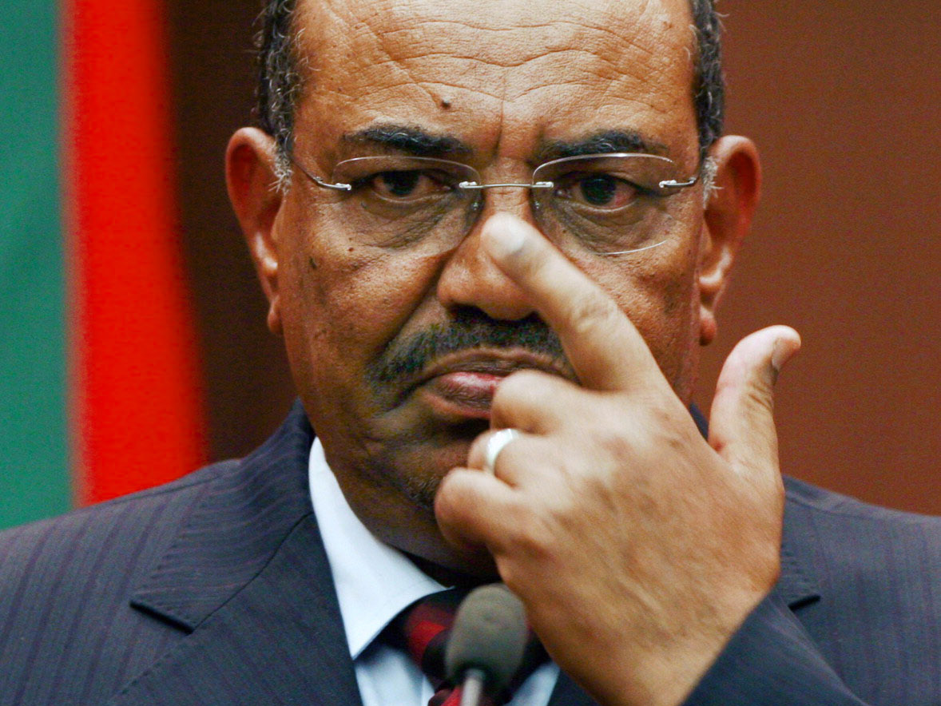
OMAR AL-BASHIR

Slide 2
Background
Born 1 January 1944 in Hosh Bannaga, Sudan
Graduated from military academy in 1967, served in Air Force
Put in command of the 8th Brigade in 1988
30 November 1989: led ouster of the coalition government of Sadeq Al-Mahdi
Headed transition gov’t before being appointed President on 16 October 1993

Slide 3
The Conflict
Began in the Western Sudanese province of Darfur in 2003
Tensions surrounding the use of land and water resources exploded between the Fur, Masalit, and Zaghawa tribes and the nomadic Arab tribes
The Sudanese government reacted with massive military operations in order to combat the rebels
Supported and armed the Arabs
Led to massive violations of human rights and numerous attacks on civilian populations and targets

Slide 4
UN Investigative Commission on Darfur
Testifies to the occurrence of mass executions, mass rapes, the expulsion of the civilian population, the destruction of villages by the Janjaweed militia group, etc.
  All of this happened with at least the TACIT approval of the Sudanese government

Slide 5
The Cost
Both sides of the conflict have mainly attacked civilians
  At least 300,000 dead since beginning of the conflict
  More than 2.7 million displaced
In 2008
  More than 315,000 new IDP’s and refugees were counted in Eastern Chad

Slide 6
Peace Accord Signed on May 5, 2006
Between the Sudanese government and one of the rebel groups (the Sudanese Liberation Army)
Accord did not hold
  Rebel groups who had not participated in the Accord organized themselves into the National Redemption Front and attacked an Army stronghold in July of 2006

Slide 7
International Community Unsuccessful
AU troops have been stationed in Sudan since August 2006
  Have not been able to stop massacres and have been under attack themselves
UNSC Resolution 1706 (2006) authorized the transfer of UN troops (UNMIS) to the region
  The Sudanese government refused this movement of personnel
  By November 2006, AU and UN troops had joined forces in a hybrid mission which is still in Sudan today

Slide 8
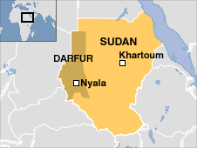
Accused of…
Genocide:
  Killing members of the Fur, Masalit and Zaghawa ethnic groups
  Causing members of these groups serious bodily or mental harm
  Inflicting conditions of life calculated to bring about these groups' physical destruction
Crimes against humanity:
  Murder
  Extermination
  Forcible transfer
  Rape
  Torture
War crimes:
  Attacks on civilians in Darfur
  Pillaging towns and villages

Slide 9
Allegedly…
Promoted and provided impunity to his subordinates in order to secure their willingness to commit genocide
Mobilized the entire state apparatus of Sudan to subject 2,450,000 people living in camps for internally displaced persons, most members of the target group, to conditions of life calculated to kill them
Obstructed international assistance
Organized well-coordinated attacks on the IDP camps

Slide 10

July 14, 2008
The ICC Prosecutor presented evidence showing that Al-Bashir did all these things (genocide, crimes against humanity, war crimes)

Slide 11
The International Criminal Court
Three years after the UNSC asked him to investigate in Darfur, the Prosecutor concluded that there were reasonable grounds to believe Al-Bashir bears criminal responsibility in relation to 10 counts of genocide, crimes against humanity, and war crimes
4 March 2009
  Arrest Warrant issued against Al-Bashir
  First ever warrant issued against a sitting head of state

Slide 12
The Warrant
Lists 7 counts as the basis of his individual criminal responsibility
  5 counts of crimes against humanity
    Murder, extermination, forcible transfer, torture, rape
  2 counts of war crimes
    Intentionally directing attacks against civilian non-combatants
  Original arrest warrant did not include the charge of genocide

Slide 13
Why?
The Trial Chamber indicated that there was not enough evidence to prove that the Gov’t of Sudan acted with specific intent to destroy, in whole or in part, the Fur, Masalit, or Zaghawa groups
However…
  The Court was open to charging Al-Bashir with genocide if the prosecutor could find additional evidence

Slide 14
The ICC transmitted a request for the arrest of Al-Bashir
With absolutely no result in Sudan
  Sudanese authorities do not recognize the legitimacy of the Court
  Unlikely that the African Union and the Arab League will cooperate as well
    They argue that the peace process should not be jeopardized and that the ICC only targets the African continent
      If they fail to comply, the matter will be referred back to the UNSC

Slide 15
By July 12, 2010…
A second arrest warrant was issued for Al-Bashir for 3 counts of genocide
  Genocide by killing
  Genocide by causing serious bodily/mental harm
  Genocide by deliberatley inflicting on each target group conditions of life calculated to bring about the group’s physical destruction
    The 1st arrest warrant is still in effect, nothing in the 2nd warrant replaces or revokes it

Slide 16
Sudan’s Reaction
Refused to comply with ICC in any way even following injunctions by the Court to do so
Sudan is obliged to comply with the ICC because Resolution 1593 was adopted under Chapter 7 of the UN Charter
  The day after the investigation began at the ICC, the Sudanese government created the Special Criminal Court on the Events in Darfur
  This court was created solely to derail the ICC investigation by abusing the principle of complementarity in Article 17 of the Rome Statute

Slide 17
What’s Happening Now?
Nothing really…
  Al Bashir is still at large
  Has traveled around Africa, no one will arrest him
  Fighting in Darfur still continues…

