Slide 1
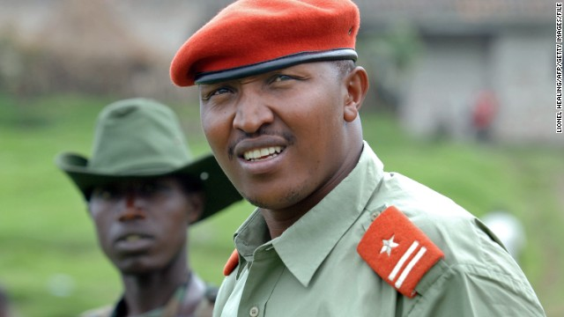
General Bosco Ntaganda, “The Terminator”

Slide 2
A little background…
Bosco, 39, was born in Rwanda but grew up in DRC and was a Congolese national
Military career consists of almost 20 years of fighting, first in Rwanda, then in various rebel groups fighting for control over a mineral-rich part of eastern Congo
Also had a stint as a general in the Congolese Army
Up until March 17, he was rebel commander of M23 in Congo
One of the most ruthless and cruel of Congo’s rebel leaders

Slide 3
Accusations
Terrorizing villagers
Pillaging
Raping
Killing
Persecution
Sexual slavery
Using drugged children as foot soldiers and henchmen

Slide 4
The ICC steps up
The ICC issued an arrest warrant in 2006 and again in 2012
The 2006 warrant was for atrocities committed in 2002 and 2003 in Congo
Bosco lived openly seemingly untouchable until…

Slide 5
Knock Knock…
On March 17, General Bosco Ntaganda surprisingly shows up at the US Embassy in Kigali, Rwanda
Asked diplomats to turn him over to the ICC
Some suggest that there were threats on Bosco’s life so he fled to the embassy
Some say the Rwandan government urged him to turn himself in

Slide 6
His time in court
Was not asked to enter a plea but stated, “I was informed of these crimes, but I plead not guilty”
When asked to state his profession, he simply said, “I was a soldier in the Congo”

Slide 7
Charges
Charged with 10 counts of...
War crimes
  Enlisting and using children under the age of 15 as soldiers
Crimes against humanity
  Murder, rape, sexual slavery and pillaging

Slide 8
What’s to come?
Nothing has been determined yet
Only the charges have been brought forth on General Bosco Ntaganda
The next hearing is scheduled for September 23
  This will determine whether or not there is enough evidence to proceed to trial

